Slide 1
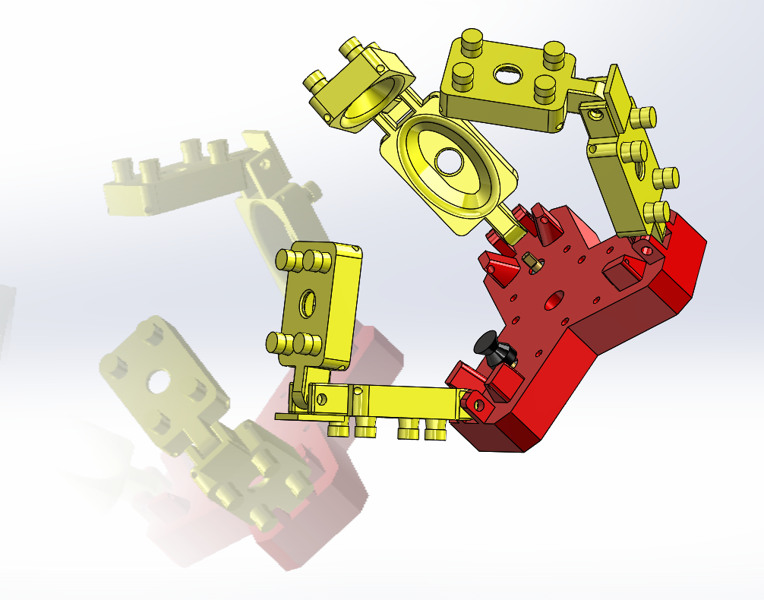
Soft Jamming Robotic Gripper
An alternative approach to a compliant hand
Douglas Tilley & Liam Grazier

Slide 2
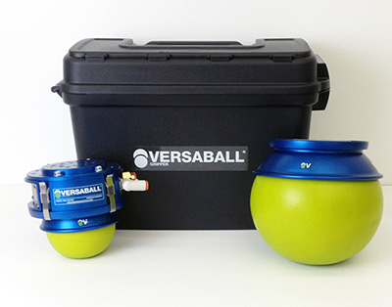
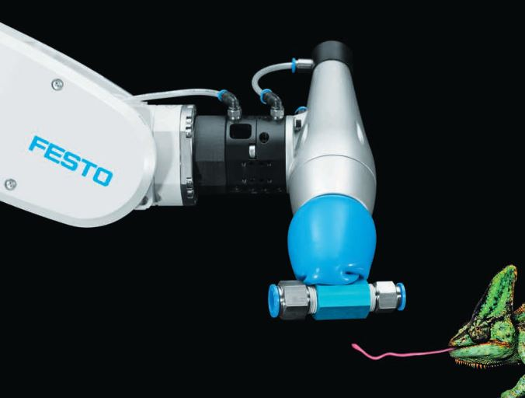
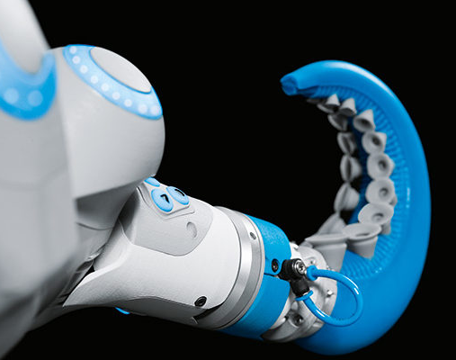
Why a hybrid?
In modern robotics, generally 3 different types of gripper are found, these are solid grippers, soft grippers and hybrid grippers.
A brief comparison
Solid Grippers
Pros
Cheap
Robust, tried design
Predictable Behaviour
Cons
No Compliance
Simple
Requires a lot of human programming and path planning
Designed specifically for one job
Hybrid Grippers
Pros
Often designed for multiple jobs
Efficient
Carry some compliance
Predictable Behaviour
Cons
Research based designs currently
Expensive
Can be unique/untested
Soft Grippers
Pros
Compliant behaviour
Cons
Research based designs currently
Difficult manufacturing process
Can often be unpredictable
The point of the hybrid design of gripper is to take the compliance of a Soft robotic gripper and to combine it with the predictable behaviour of the solid gripper.
This allows for a wider range of tasks to be performed.
Festo, a US based company, has done lots of research into Soft pneumatic grippers.

Slide 3
Project Progress:
Task | 30/09/2018 | 07/10/2018 | 14/10/2018 | 21/10/2018 | 28/10/2018 | 04/11/2018 | 11/11/2018 | 18/11/2018 | 25/11/2018 | 02/12/2018 | 09/12/2018 | 11/12/2018
Initial Project Design
Preliminary Prototype of Digit
Materials Research and Eval
Motor Research and Requisition
Electronics Development
Rapid Prototyping + Development
Final Build + Intergration of all systems

Slide 4
Design key structure
Base
The base required a minimum size to be able to wrap around the objects but also it was necessary to not be too small as to cause collisions
The hybrid gripper is broken down into 5 main parts:-
Finger
Base
Jamming principle
Air vs Water
Filter type
Outer material
Electronics
Code
Each of these sections had their own design development
Jamming Principle
It was necessary to do some tests into how the different materials functioned when used in the gripper.
One of the main issues here was the ability to make the system air tight.
Electronics
Motor choices, board choices, wiring methods and power consumption must be considered in this part.
Finger
The main design choice here was how to integrate the soft jamming gripper into the finger whilst keeping the manipulation ability.
Another consideration was the modularity and link number.
Code
The code for each digit must be non-blocking to allow each finger to be controlled independently.

Slide 5
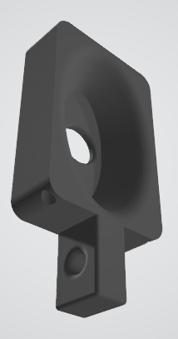
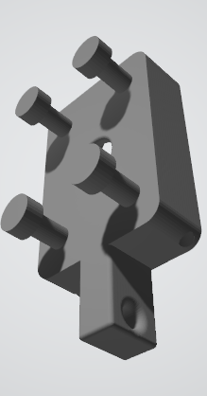
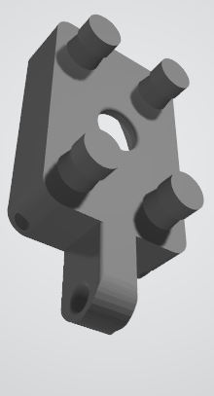
Design progression
Over the course of this project the design has changed in various ways due to limitations and improvements found.
The rapid prototyping focus of this project meant that each part was developed and improved multiple times with the number of design iterations listed below:
Finger – 7 iterations
Starting out as a simple square and no additional features.
Added and moved the height of the tendon holes.
Posts on the back of the finger were added to give an elasticated limit.
The posts couldn’t deal with the forces exerted when 3D printed and hence were thickened.
Bases – 3 iterations
Started out as a fixed square intending to be a hand formation.
This was quickly changed to a 3 pronged design.
Had to change the base design due to motor design change.
The base was made larger and features removed for simplicity.
Pneumatic Rack – 1 iteration
Spindles – 2 iterations
Initially designed for a specific motor
Had to be adapted due to technical challenges
CAD Preview of the different iterations of designing the finger parts

Slide 6
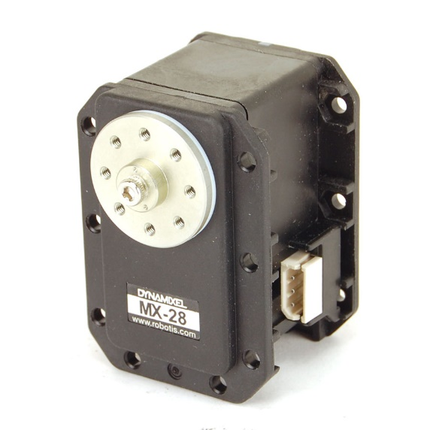
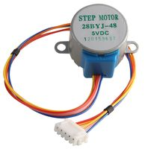
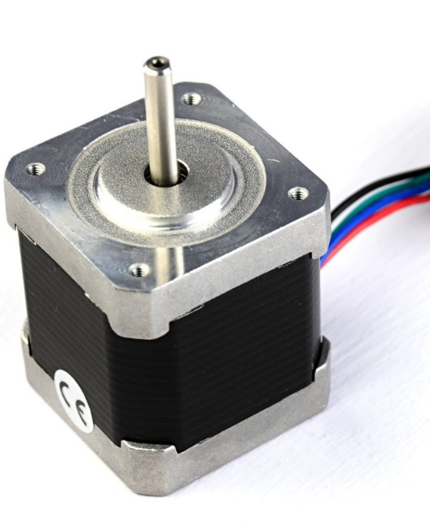
Electronic progression
The basis of this project was around the motors that had to be used. They had 2 tasks and each required 3 motors. This was the individual finger control and individual finger pneumatic control.
Due to various issues encountered during programming, the project changed motors 3 times.
Robotis Dynamixel MX-28
Originally this motor was intended to be used, however the motors were unresponsive to programming and hence had to be swapped out for a different stepper.
28BYJ-48 5V DC Stepper Motor
These were the second motors looked at for use in this project, using ULN2003 Chips to control the stepper motor.
However the stall torque of the motors was too low and hence couldn’t be used.
Nema17
Nema17s carry industry weight as being reliable and easy to program whilst having a reasonable stall torque.
Electronic Developments:
Had issues controlling motors.
Started developing low power stepper motor solution.
Multiple Stepper Motor Controller developed for six motors.
Three for tendon control.
Three for crushing control.
Issue found using 28BYJ-28 stepper motors. Not powerful enough for either task, switched out for NEMA17 Stepper motors .

Slide 7
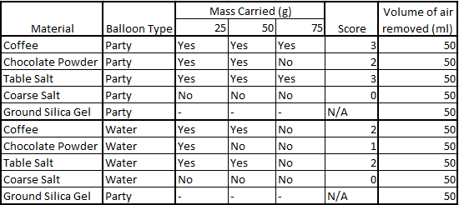
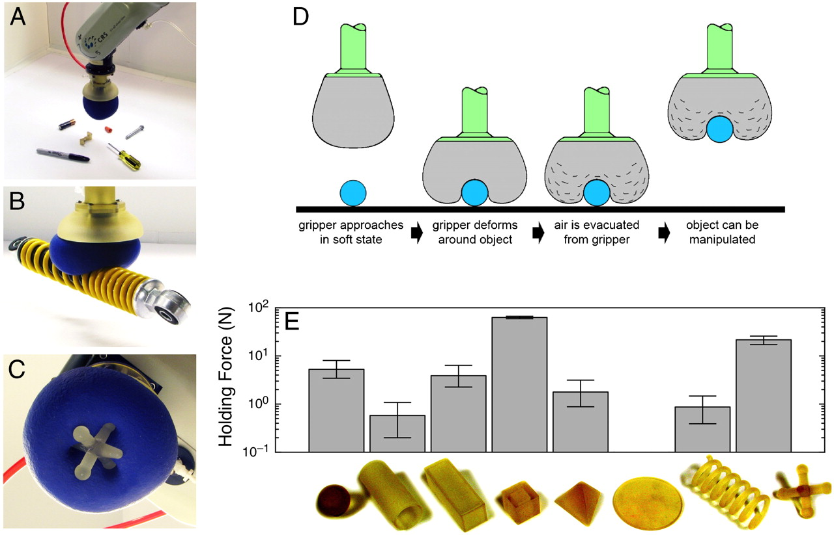
Materials Research
To make sure that the Jamming principle worked, materials research was necessary.
A basic test right was designed to obtain some numerical data which can be shown below:
From this data, a scoring system was gauged and the materials choices were edited.
However, from research articles, the material that is being gripped has a large impact on the ability to grip.
A paper was conducted by Brown et al. into the shape, material and principle of the jamming gripper.
In their tests for strength and minimum contact area, a spherical object was used.
To conclude the packing density of the balloon matters the most whilst only a small area of the target object has to be in contact to grip.

Slide 8
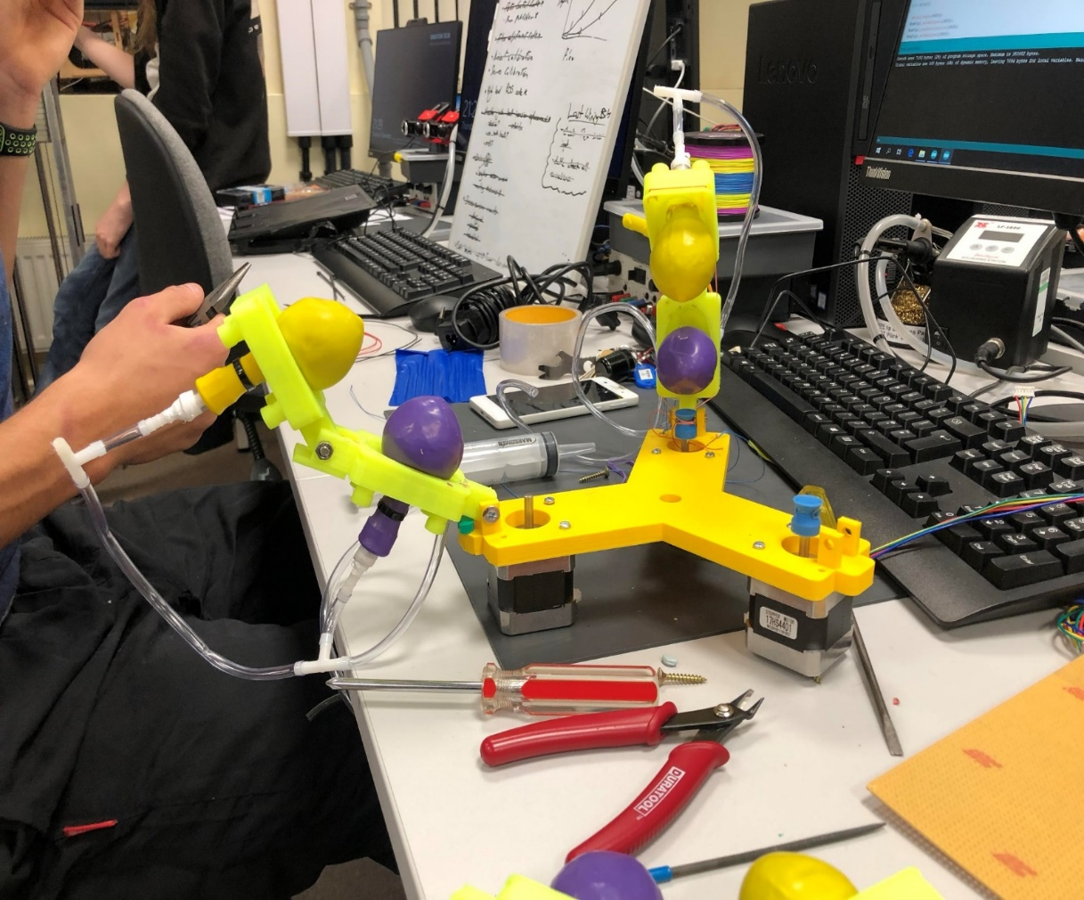
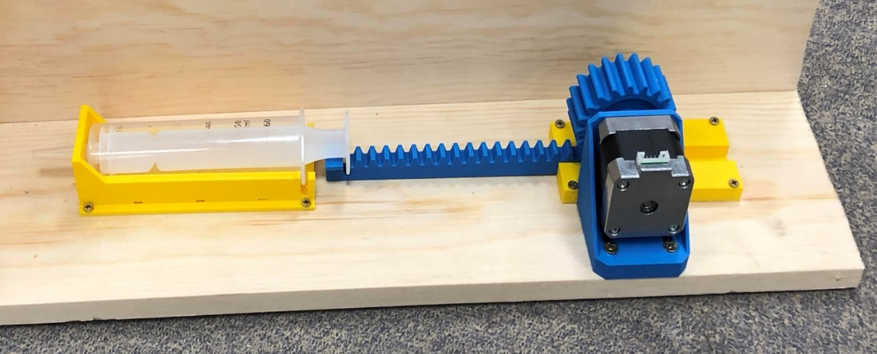
Project Development
Aims, Achievements and Future development
Aims
Individual finger control
Pneumatic Control
Ability to grip
Achievements
Individual Finger Control
Automatic Rack and Pinion Control
Some ability to grip
Future Developments
Improve the interfacing between digit and base
Make the pneumatics air tight
Reduce sizes.
Necessary changes
Currently each finger can be position controlled, however it is a rough working with some flaws.
The air system is not sealed correctly, however the principle works(See table). Hence the pneumatics need an overhaul.
Friction of the syringe limits its ability due to torque issues with motors.
Design needs to be optimized still.
Conclusion
The Soft jamming robotic gripper, when fully functional will provide added gripping ability to a traditional gripper, however getting to the stage where this works is difficult.

Slide 9
References & Bibliography
Eric Brown, Nicholas Rodenberg, John Amend, Annan Mozeika, Erik Steltz, Mitchell R. Zakin, Hod Lipson, and Heinrich M. Jaeger, Universal robotic gripper based on the jamming of granular material, PNAS, 107 (44) (2010) 18809-18814; 10.1073/pnas.1003250107
https://www.pnas.org/content/107/44/18809
F. Iida, C. Laschi, Soft robotics: challenges and perspectives, Procedia Comput. Sci. 7 (29) (2011) 99–102; 10.1016/j.procs.2011.12.030
https://www.sciencedirect.com/science/article/pii/S1877050911006958
John R. Amend, Eric M. Brown, Nicholas Rodenberg, Heinrich M. Jaeger, and Hod Lipson, A Positive Pressure Universal Gripper Based on the Jamming of Granular Material, IEEE Transactions on robotics, 28 (2) (2012); 10.1109/TRO.2011.2171093
https://jfi.uchicago.edu/~jaeger/group/JaegerGroupPapers/granular/TRO2171093.pdf
Nagase, Jun-ya, Shuichi Wakimoto, Toshiyuki Satoh, Norihiko Saga, and Koichi Suzumori. "Design of a variable-stiffness robotic hand using pneumatic soft rubber actuators." Smart Materials and Structures 20, no. 10 (2011): 105015.
http://iopscience.iop.org/article/10.1088/0964-1726/20/10/105015/meta
Useful Links:
https://www.festo.com/cms/en-gb_gb/index.htm
https://www.pneumatictips.com/going-soft-on-grippers/

